Slide 1
LECTURE 1

Slide 2
D
E
B
C
A

Slide 5
y'
y
r_{B/A}
B
A
x'
r_{A}
Translating reference frame (coordinate system)
r_{B}
O
x
Fixed reference frame (coordinate system)

Slide 6
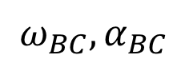
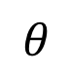
B
A
$$ω_{BC}, α_{BC}$$
$$θ$$
C

Slide 7
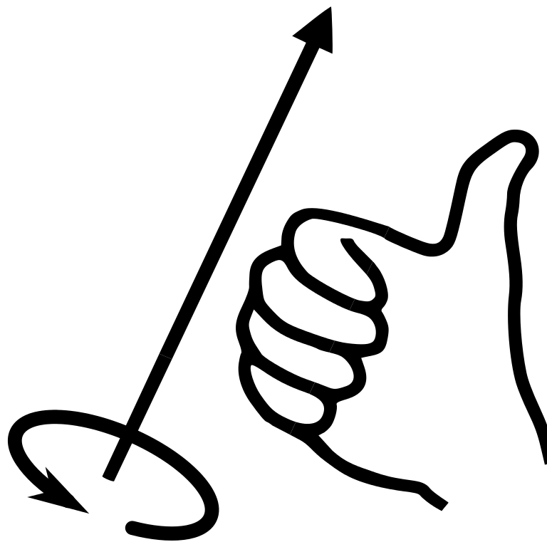
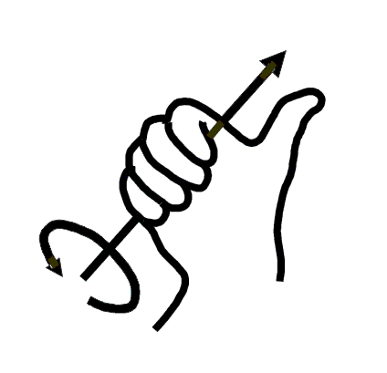
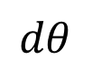
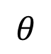
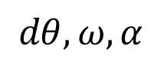
$$dθ, ω,α$$
ADD RH RULE HAND
O
r
P
$$θ$$
$$dθ$$

Slide 8
$$dθ, ω,α$$
O
r
P
$$θ$$
$$dθ$$

Slide 9
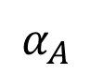
B
$$α_{A}$$
A
0.05 m
0.15 m

Slide 10
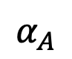
$$α_{A}$$
A
B
0.05 m
0.15 m

Slide 11
LECTURE 2

Slide 12

Y
y
A
B
x
X

Slide 13
y'
y'
A
dr_{A}
x'
A
x'
r_{B/A}
r_{B/A}
B'
dr_{B/A}
dr_{A}
B
B
dr_{B}
Rotation
Translation

Slide 14
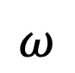
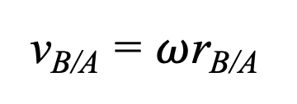
v_{A}
A
A
$$ω$$
v_{B/A}
v_{B/A} = $ω$r_{B/A}
v_{B =} v_{A +} v_{B/A}
+
r_{B/A}
=
v_{A}
B
v_{A}
B
Rotation about the base point A
Translation

Slide 15
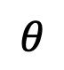
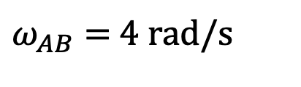
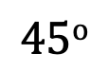
125 mm
C
$$45o$$
B
$ω_{AB}$ = 4 rad/s
300 mm
$$θ$$
A

Slide 16
LECTURE 3

Slide 17
ω
A
v_{A}

Slide 18
y
ω
A
v_{A}
x

Slide 19
B
ω
A
v_{A}

Slide 20
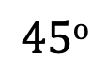
B
300 mm
$$45o$$
A

Slide 21
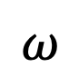
Centrode
IC
v_{IC} = 0
$$ω$$
r_{A/IC}
v_{A}
A

Slide 22
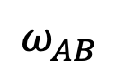
A
$$ω_{AB}$$
0.2 m
B
v_{B} = 2 m/s

Slide 23
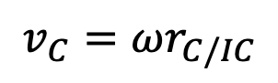
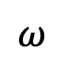
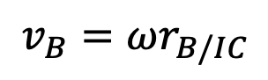
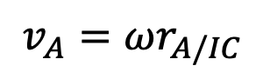
IC
r_{B/IC}
r_{C/IC}
r_{A/IC}
$$v_{B}=ωr_{B/IC}$$
B
$$ω$$
$$v_{C}=ωr_{C/IC}$$
C
A
$$v_{A}=ωr_{A/IC}$$

Slide 24
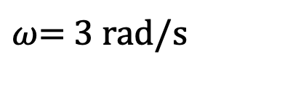
B
G
A
0.75 ft
0.5 ft
$ω$= 3 rad/s

Slide 25
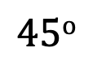
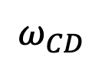
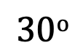
6 in.
B
A
$$30o$$
8 in.
$$45o$$
C
$$ω_{CD}$$
D
4 in.

Slide 26
LECTURE 4

Slide 27
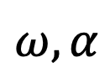
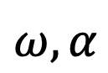
Path of point A
a_{A}
a_{A}
$$ω,α$$
A
A
A
a_{B/A}
r_{B/A}
$$ω, α$$
a_{B}
=
+
a_{A}
(a_{B/A})_{n}
(a_{B/A})_{t}
B
B
B
Path of point B
General plane motion
Rotation about the base point A
Translation

Slide 28
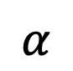
y
x
$$α$$
$$ω$$
B
G
A

Slide 29
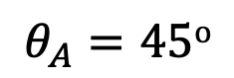
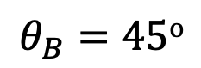
y
B
1 m
x
1 m
$$θ_{B}=45o$$
$$θ_{A}=45o$$
C
A

Slide 30
LECTURE 5

Slide 31
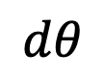
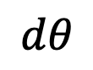
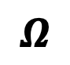
y'
$$dθ$$
$$dθ$$
dj'
x'
di'
j'
i''
j''
i'
i = 1
j = 1
$$Ω$$

Slide 32
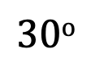
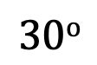
E
B
C
1 m
$$30o$$
D
y
$$30o$$
x'
y'
1 m
A
x

Slide 33
LECTURE 7

Slide 34
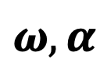
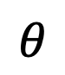
v_{A}
A
$$ω,α$$
$$θ$$
y
r
B

Slide 35
LECTURE 8/9

Slide 36
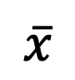
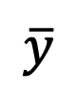
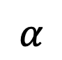
a)
b)
y
35 mm
r
15 mm
$$α$$
110 mm
C
x
C
$$α$$
r
$$\overline{y}$$
50 mm
$$\overline{x}$$

Slide 37
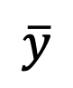
p
p
dF
dA
F_{R}
y
y
$$\overline{x}$$
x
x
$$\overline{y}$$

Slide 38
y
Surface of liquid
w₁ = bp₁
C
F_{R}
z
w₂ = bp₂
L
P
y'

Slide 39
p
y
p = 2y^{1/2}
4 m
x
2 m
4 m

Slide 40
y
w
h
x

Slide 41
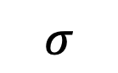
z
dA
M
dF
$$σ$$
x
z
y

Slide 42
y
x
A
dA
r
y
O
x

Slide 43
y
w
h
x

Slide 44
z
r
dm

Slide 45
z
R
h/2
y
O
h/2
x

Slide 46
z
y
l
x
A

Slide 47
y'
dm
r
A
G
r'
x'
d
x'
z
z'

Slide 48
O
G
150 mm
1.4 m
1.4 m

Slide 49
LECTURE 10/11

Slide 50
y
F_{i}
x
f_{i}
i
y
r
P
x

Slide 51
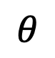
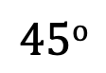
a_{t}
B
A
$$45o$$
G
$$θ$$
0.4 m

Slide 52
G
8”
a
1.5”
1.5”

Slide 53
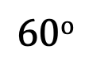
A
D
y
+
x
$$60o$$
m = 10 kg
G
B
C
1 m

Slide 54
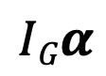
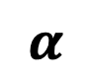
$$α$$
P
m(a_{G})_{t}
$$IGα$$
m(a_{G})_{n}
G
r_{GP}
O
r_{OP}

Slide 55
A
B
The Hanging Axe

Slide 56
LECTURE 12/13/14

Slide 57
D
A
90 mm
C
B
90 mm

Slide 58
y
+
x
G
P
G
M
W
W
f
f
N
N

Slide 59
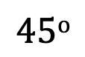
B
y
+
x
A
l
G
$$45o$$
C

Slide 60
y
+
x
l
G
A
B
C

Slide 62
LECTURE 15/16/17

Slide 63
WORK
STATE 1 at t = t₁
STATE 2 at t = t₂

Slide 64
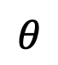
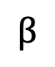
$$θ$$
s
$$β$$

Slide 65
Unstretched position, s = 0
F_{S}
s
ds
s₁
s₂
F_{S}

Slide 66
y
+
x

Slide 67

y
+
x
$$ω$$
G
A

Slide 68


A
$ω_{AB}$= 3 rad/s
3"
4"
C
B
5"
$$45o$$
D

Slide 69
g
G
y_{G} = h
y = 0
y_{G} = -d
G

Slide 70
s = 0
s₁
s₂

Slide 71
A
12"
C
k = 2 lb/in.
10"
B

Slide 72



O
$$θ$$
$$\frac{l}{3}$$
$$\frac{2l}{3}$$

Slide 73
LECTURE 18

Slide 74
x
k
m

Slide 75




x(t)
1 cycle $= 2π= ω_{n}τ$
$$φ$$
1 period (time) $=τ$
C
Slope at
t = 0 is v₀
x₀
$$ω_{n}t$$
C

Slide 76




$$C =\sqrt{{\left(\frac{v_{0}}{ω_{n}}\right)}^{2}+ x_{0}^{2}}$$
$$B=x_{0}$$
$$φ=\tan^{−1}\left(\frac{x_{0}}{{v_{0}}/{ω_{n}}}\right)$$
$$A= \frac{v_{0}}{ω_{n}}$$

Slide 77

k
O
b = 0.3 m
$$θ$$
a = 0.2 m

Slide 78

$$θ$$
l
m
s

Slide 79
Imaginary
Real

Slide 80
k = 3500 N/m
0.25 m
O
B

Slide 81
LECTURE 20

Slide 82

x_{eq}
x
k
m
$$F=F_{0}\sin{ωt}$$

Slide 84


x_{C}
Complementary Solution
$$ω_{n}$$
x_{C}
$$t$$

Slide 85

x_{P}
Particular Solution
x_{P}
$$ω_{0}$$
$$t$$

Slide 86
x_{G}
x_{G} = x_{C} + x_{P}
General Solution
$$t$$

Slide 87

MF
$$\left(\frac{ω_{0}}{ω_{n}}\right)$$
Notes:
0

Slide 88


$$x(t)$$
$$t$$

Slide 89

F(t)
m
k
k
k
k

Slide 90
F(t)
m
k

Slide 91
⍵

Slide 92
LECTURE 21/22

Slide 93


Unstretched spring position
c
k
$$Δ$$
x = 0
m
x
Equilibrium position

Slide 94


$$c\frac{dx}{dt}$$
$$k(Δ+x)$$
x
mg

Slide 95
x_{eq}
x
k
m

Slide 96














$$x(t)$$
Underdamped response
$$De^{−ζω_{n}t}$$
D
$$x_{1}$$
$$τ_{d}$$
$$x_{2}$$
$$x_{3}$$
$$x_{4}$$
$$t_{1}$$
$$t_{2}$$
$$t_{3}$$
$$t_{4}$$
$$t$$
D
$$De^{−ζω_{n}t}sin⁡(ω_{d}t+φ)$$
$$−De^{−ζω_{n}t}$$

Slide 97












$$\left(x_{0} − \frac{4μmg}{k}\right)$$
Friction damping response
$$x0$$
$$τ_{n}$$
Spring force ($F_{k}=x\left(t\right)∗k$) at the turnaround ($v(t)=0$) is less than that needed to overcome static friction
$$x(t)$$
$$\left(x_{0} − \frac{8μmg}{k}\right)$$
$$0$$
$$t$$
Slope $= \frac{2μmgω_{n}}{πk}$
$$−\left(x_{0} − \frac{6μmg}{k}\right)$$
$$−\left(x_{0} − \frac{2μmg}{k}\right)$$
$$\left(x_{0}−\frac{\left(2n−1\right)μmg}{k}\right)\cos{ω_{n}t + \frac{μmg}{k}{(−1)}^{(n+1)}}$$

Slide 98
x
m
c
k

Slide 99
LECTURE 23

Slide 100


L = mv_{G}
$$ω$$
$$HG=IG ω$$
G
r_{G}
O

Slide 101
LECTURE 24/25/26

Slide 102


$$ω$$
g
r
B
$$30o$$
$$60o$$

Slide 103

l
$$ωD$$
r
A
B
Top View

Slide 104
L_{B1} = m_{B}v_{B1}
L₁ = L₂ = m_{A}v_{A1} + m_{B}v_{B1}
L_{A1} = m_{A}v_{A1}

Slide 105
m_{A}v_{A1}
m_{B}v_{B1}

Slide 106




y
(v_{A})₂
(v_{B})₂
A
B
$$θ_{2}$$
$$φ_{2}$$
Line of impact
x
$$θ_{1}$$
$$φ_{1}$$
Plane of contact
(v_{B})₁
(v_{A})₁

Slide 107
m_{A}(v_{A})₁
m_{B}(v_{B})₁
A
B
(v_{A})₁ > (v_{B})₁
Before impact

Slide 108


$$\int{P dt}$$
$$−\int{P dt}$$
Effect of A on B
Effect of B on A
A
B
Deformation impulse

Slide 109
v
A
B
Maximum deformation

Slide 110


$$\int{R dt}$$
$$−\int{R dt}$$
Effect of A on B
Effect of B on A
A
B
Restitution impulse

Slide 111
m_{A}(v_{A})₂
m_{B}(v_{B})₂
A
B
(v_{B})₂ > (v_{A})₂
After impact

Slide 112


m_{A}(v_{Ay})₁
m_{A}(v_{Ay})₂
A
A
$\int{F dt}$
m_{A}(v_{Ax})₂
A
+
=
m_{A}(v_{Ax})₁
m_{B}(v_{By})₁
m_{B}(v_{By})₂
$\int{F dt}$
B
B
B
+
=
m_{B}(v_{Bx})₁
m_{B}(v_{Bx})₂

Slide 113
A
mv_{C}
C
B

Slide 114

r
A
l
$$θ$$
B
r

Slide 115

B
G
A
$$30o$$
1 m

Slide 116
LECTURE 19

Slide 117

Unstretched spring position
m
$$Δ$$
x = 0
x(t)
Equilibrium position

Slide 118

x
$$kΔ$$
m
mg
Equilibrium position

Slide 119

$$θ$$
r
R

Slide 120
M
M
h
h
G
G

